Slide 1


Re(Development)
A pathway to supporting effective stewardship of
Presbyterian land and properties
Ainsley Chapman, Executive Director, Evangel Hall Mission
Karen Plater, Associate Secretary, Stewardship & Planned Giving
Betty Kupeian, Chief Operating Officer, Presbyterian Church Building Corporation

Slide 2
Protocol
KP
Stay muted and use chat to ask anything
Chat will be monitored and questions asked as we go along and at the end
There will be an opportunity to unmute at the end

Slide 3

Recording
KP
KP
Recording & Slides will be available at
presbyterian.ca/webinars/
Share it around!
Notes:
Recordings will also be posted at https://presbyterian.ca/leadership-webinars/ for people to find and use in the future.

Slide 4
Re(Development)
A pathway to supporting effective stewardship of
Presbyterian land and properties
Ainsley Chapman, Executive Director, Evangel Hall Mission
Karen Plater, Associate Secretary, Stewardship & Planned Giving
Betty Kupeian, Chief Operating Officer, Presbyterian Church Building Corporation

Slide 5
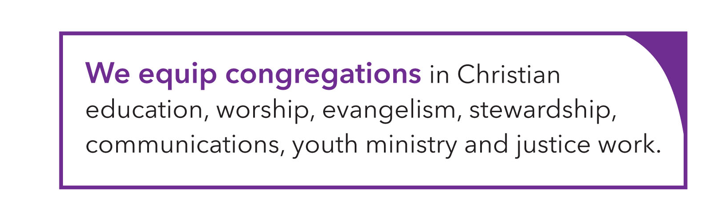
KP
Notes:
This work is supported by your gifts to Presbyterians Sharing . . .

Slide 6
Land Acknowledgement
BK
We acknowledge that congregations across Canada are on the traditional territories of various Indigenous peoples.
The Presbyterian Church in Canada national offices are on the traditional territory of the Huron-Wendat, Petun, Seneca and, most recently, the Mississaugas of the Credit Indigenous Peoples.
We are on a journey of healing and reconciliation between Indigenous and non-Indigenous Peoples.

Slide 7
AC
Re(Development)
This type of redevelopment is more than renovating an existing building to better serve the congregation. It is a revisioning/reworking of buildings and property to maximize service to the community through housing and/or community space for the common good.
Notes:
AC - Our goal is to establish long-term plans for the sustainability of ministry and facilities. It could be done by a Presbyterian congregation, ministry or a presbytery who thinks a building/property under their stewardship could be redeveloped to serve the community. As of February, over 30 groups (congregations and presbyteries) have expressed an initial interest in such grants. While a few of the groups have already begun this work and are well on their way, discussions over the past six months have shown that many of them will need professional development experience to help the congregation discern their assets (building, land, people), community needs, municipal priorities etc. to determine the best way to steward the land and property to serve the community and congregation at this time. Both those who have already begun and those poised to begin have expressed a need for funding.

Slide 8
What do we mean by housing?
AC
Affordable Housing: $45,000-$90,000 family income
Nurses, teachers, delivery truck drivers, personal support workers, lab technicians, early childhood educators, seniors
Deeply Affordable/Rent-geared-to-income: <$45,000 family income
Grocery store workers, dishwashers, restaurant servers, shelter workers, lab assistants, people on disability insurance, retail workers, seniors
Housing with supports for life skills (independent living)
Life skills coaching, advocacy, information and referral, seniors
Supportive housing with medical supports
Brain injuries, developmental disabilities, chronic mental health conditions, addictions, seniors
Notes:
AC

Slide 9
What do we mean by space for social good?
AC
Community Space/Third Space
Partners & tenants who support community development by addressing food security, social isolation and loneliness, education
Small businesses/entrepreneurs (music, dance, yoga)
Community activities (girl guides, AA)
Charities, Nonprofits, Social Services (seniors’ fitness, community meals, food banks, ESL & welcome programs for new Canadians)
Partnerships with local municipality (library relocation, city-funded day care)
Notes:
AC

Slide 10
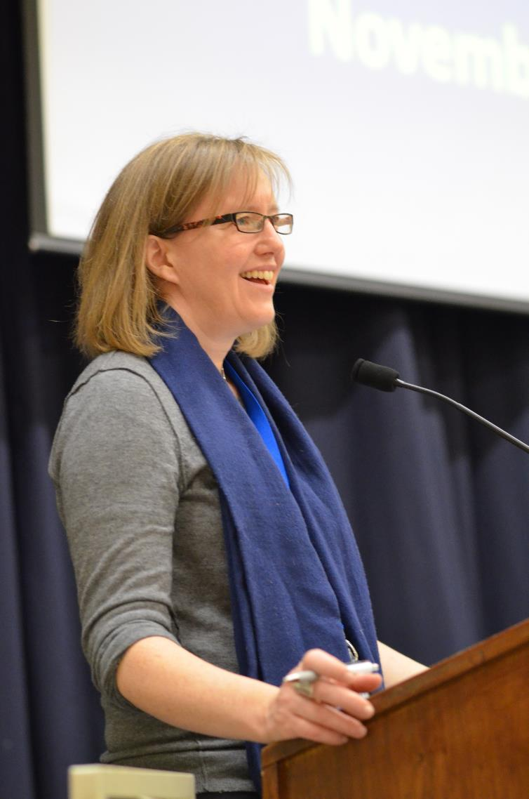
Staff Support: Karen Plater
KP
Knowledge & Skills
Education in Community Development
29 years working for The Presbyterian Church in Canada,
18 years working with congregations & specialized ministries on raising funds to support ministry
Supporting congregational treasurers, lay leaders & ministers
Stewards by Design organizer 2007-2019
Notes:
KP

Slide 11
What is Karen Plater doing?
KP
Liaising with and supporting Ainsley
Communication about program
Mentoring and coaching
Facilitating the committee to review grants and develop application process
Organizing consultations
Participating in ecumenical collaboration
Notes:
KP

Slide 12

Staff Support: Betty Kupeian
BK
Knowledge & Skills
Professional Accountant CPA with over 35 years experience serving non-profit and for profit organizations
Chief Operating Officer of Presbyterian Church Building Corporation (PCBC) since 2020
Coordinator of Lending Services all loans available through the PCBC and The Presbyterian Church in Canada (PCC)
Engaged in several national church boards and committees
Committed Presbyterian for over 35 years
Notes:
KP

Slide 13
What is Betty Kupeian doing?
BK
Determining financing and project requirements for entities of the PCC across Canada
Communication about PCBC and loans process
Supporting and encouraging congregational leadership through the process
Consultant to the committee to review grants and develop application process
Responsible for risk analysis of all loan applications
Active in housing conferences and ecumenical collaborations
Notes:
KP

Slide 14

Evangel Hall & PCC Collaboration
AC
Working together to support congregations
Notes:
AC – mention strategic planning work EHM has done

Slide 15
About the Collaboration
AC
2019
Evangel Hall Mission Strategic Planning Exercise
2019–2024
Ad hoc PCC working group on re-development of properties
Fall 2023
Survey on interest of congregations
Oct. 2024
Signing of 4-year MOU with EHM
Nov. 2024
Assembly Council direction to explore helping congregations with exploratory and pre-development work.
Mar. 2025
Assembly Council frees $2.5 million to support congregations exploring redevelopment with grants
Notes:
KP – the wok of PCC – began with LMA, Stewardship, CM, GAO, PCBC, Church Architects – all being asked similar questions – began to meet together to see what could be done. Brought in Ainsley.
Led to formal MOU
Karen and Ainsley working as a team
Committee to provide grants
Larger picture being worked on by Narratives of Hope and Possibility
In addition to funding, most of the groups need or appreciate learning about the possibilities, some level of mentoring and coaching through the processes and learning from those who have already been through or are going through this process.

Slide 16
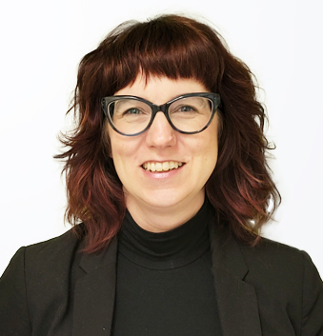
Staff Support: Ainsley Chapman
AC
Knowledge & Skills
Seneca Sustainable Transportation and Planning Certificate
Housing Conferences: ONPHA, ReGen, CHRA
U of T Accelerator Program
CMHC Communities of Faith Working Group
TAEH Housing Working Group/Advisory to City of Toronto
TMASHN Supportive Housing Growth Plan
Canadian Coalition for Re-Imagining Church, Land and Community
“Rolodex” of developers, planners, architects, etc.
Notes:
AC

Slide 17
What is Ainsley doing?
AC
Represent church voices, needs, concerns
PCC
CMHC
Planning tables
Housing forums
Information, coaching, support for visioning, feasibility & pre-development planning
Referral to professionals
Notes:
AC

Slide 18
AC
Feasibility Studies
Discover Possibilities
Physical constraints of property
Political environment and government priorities
Funding environment
Community needs and interests
Clarity on housing options
Notes:
AC A consultant that you hire to do a Feasibility Study can look at all of these things, and match them to your vision and priorities.
They will look at the size of the land, how high you can build, how much density would be approved by the city, and if the goals of the project would qualify it for additional funding and getting fast-tracked through approvals. For example in Toronto, buildings with 30% affordable housing can qualify to have $100,000s in fees waived, and will fast track approvals
They look at the history of the land and see if there is a risk of expensive environmental contamination or heritage designation.
They look at how much it would cost to build, using different scenarios, and where you could get funding for this. For example, buildings with 30% affordable housing can qualify for low-interest loans, grants, and other financial supports.
They can look at community needs. Maybe the local library is looking for space and could be a building partner or a tenant in the building.
There are a wide range of types of housing you can include that will have an impact on the housing crisis. I can offer an entire workshop on types of housing, or walk your committee through your options.
There are many firms and companies that do this work for you – I can share a list.

Slide 19
AC
Feasibility Process
Clearly establish the vision (Visioning Process)
Analyze the current resources available: building, human & funding (Situation Analysis)
Map out options (Option Mapping)
Present a Preliminary Implementation Plan
Notes:
KP Circulated a template for congregations who have contacted us and we’ve had initial conversations with – around 30.

Slide 20
AC
Working with Experts
In (re)development processes (urban planning experience)
Working with communities of faith or projects with social good/social purpose, or how their values align with congregation’s vision and values.
Approaches to problem solving and course correction
We work with experts in development so congregational leaders and members can focus on mission and ministry.
Notes:
We want to know that the study was credible and the process was done, not necessarily all three applicants, but happy to talk with you about their proposals.
We are looking for professionals with a proven record of success and depth of knowledge to do the feasibility studies and how redevelopment of a building/property can fit the values and mission priorities of the congregation and be good stewardship of the resources that they oversee.
Often it’s a gut thing – important to know your congregation and see how the fit is. Might start smaller request and see if you want to work with them through the other options.

Slide 21
KP
Visioning Process
Provides vision, goals and priorities of ministry of congregation
Needs opportunities to talk about and honor history, including celebrating the past and honoring the fears and grief
Should be broad and flexible enough to adapt but focused enough to help make decisions
Helps prioritize needs, must-haves, and wants
How will it be financed? What are the available sources of financing?
NOTE: Congregations should have worked on vision for their ministry prior to applying for grants for feasibility studies. OPTIONS: New Beginnings (denominational program); Centre for Missional Studies
Notes:
AC
The RFP may then say how does congregation’s vision connect with the building and property and provide real and tangible information for both congregation and presbytery to make decisions on.

Slide 22
KP
Situation Analysis
Assess finances, building condition, usage patterns, leadership capacity, and political environment.
Financial Review
Review finances and capital reserve fund savings for financial health and resiliency
Building and Property Review
Review our existing building use and documents such as tenancy agreements, rent rolls/income
Review the property and building structures and documents, including ownership, building condition audits etc.
Neighbourhood, Community and Interested Party Review
Conduct a preliminary assessment of the land in relation to the municipality’s planning documents, policies, and by-law, to assess limitations and opportunities.
Assess the political environment and opportunities to support for changes to property.
Identify major projects being considered/planned, community demographics and needs
Internal Capacity Review
Assess the capacity of church volunteers and staff to lead and guide a project
Make recommendations for ways to build capacity
Notes:
AC

Slide 23
KP
Building Project Plan
Congregation space: worship, program & office
Social good space: program & office
Ratio of Housing (Market, Affordable, Subsidized Rent)
Commercial space
Who will build and who will operate?
Capital/Build Budget: How much it will cost to build and open
Operating/Maintenance Budget: What the annual operating/program and maintenance budget looks like over 20 years
Notes:
The consultant will work with you to help narrow down how much of everything you want in the building, and what it does to the cost to build, and the cost to operate.
For example, a project with more rent brings in more revenue. A project geared toward more affordable housing will bring in less revenue.
A project with more space for community use and rentals by nonprofits can help strengthen your connection to the community, but may mean you need to take into the needs of the community in the design, or have a smaller worship space.
The first budget will outline all the places that can contribute funding including grants, loans, and waiving fees.
The second budget will tell you how much it will cost to run the building and pay back all your loans and mortgage.
This is why your visioning is so important, because it will have a direct impact on the cost and the viability of the project, and you will need to return to it over and over.

Slide 24
KP
OPTION MAPPING
Design 2-3 options that provide opportunities to discuss, review, and refine to secure a final plan.
Notes:
The consultant will work with you to help narrow down how much of everything you want in the building, and what it does to the cost to build, and the cost to operate.
For example, a project with more rent brings in more revenue. A project geared toward more affordable housing will bring in less revenue.
A project with more space for community use and rentals by nonprofits can help strengthen your connection to the community, but may mean you need to take into the needs of the community in the design, or have a smaller worship space.
The first budget will outline all the places that can contribute funding including grants, loans, and waiving fees.
The second budget will tell you how much it will cost to run the building and pay back all your loans and mortgage.
This is why your visioning is so important, because it will have a direct impact on the cost and the viability of the project, and you will need to return to it over and over.

Slide 25
KP
PRELIMARY IMPLEMENTATION PLAN
Develop an implementation plan that shows
The timeframe
The financing needs
A schedule and budget for pre-development studies, fees and other expenses
A list of possible grants, financing options, and incentives that may be available to support this phase of work
Recommendations for how to build the capacity of the church to lead and move through the project
Recommendations for ways to proceed through the implementation plan
Notes:
The consultant will work with you to help narrow down how much of everything you want in the building, and what it does to the cost to build, and the cost to operate.
For example, a project with more rent brings in more revenue. A project geared toward more affordable housing will bring in less revenue.
A project with more space for community use and rentals by nonprofits can help strengthen your connection to the community, but may mean you need to take into the needs of the community in the design, or have a smaller worship space.
The first budget will outline all the places that can contribute funding including grants, loans, and waiving fees.
The second budget will tell you how much it will cost to run the building and pay back all your loans and mortgage.
This is why your visioning is so important, because it will have a direct impact on the cost and the viability of the project, and you will need to return to it over and over.

Slide 26
KP
Role of Advisory Committees
Be the keepers of the vision and priorities
Secure external experts
Communicate progress and updates to the congregation
Communicate and liaise with national office and Presbytery
Notes:
AC
Make sure the Vision/Priorities are informed by the congregation, are clear, and are the basis on which future decisions are made
Secure external experts to help at each stage
Make sure consultants/developers are reflecting the Vision/Priorities in their work
Communicate progress and updates to the congregation
Follow the advice of experts, esp. during community engagement and government relations
Communicate and liaise with national office and Presbytery on issues of polity

Slide 27
KP
Helpful Committee
is well connected to members of the congregation/presbytery
bridge connections to the community and local agencies
help the project stay on track with its vision
keep the congregation motivated – are good listeners and strong communicators
build the trust of the community and get them excited
They have time and energy
Can come from another congregation or community members
Staying power, Able to see the project to completion (often 5-10 years)
Notes:
Make sure the Vision/Priorities are informed by the congregation, are clear, and are the basis on which future decisions are made
Secure external experts to help at each stage
Make sure consultants/developers are reflecting the Vision/Priorities in their work
Communicate progress and updates to the congregation
Follow the advice of experts, esp. during community engagement and government relations
Communicate and liaise with national office and Presbytery on issues of polity

Slide 28
KP
Not Helpful Committee
Tries to do the work in lieu of hiring experts
Committee members may have experience (development, real estate, construction, finance, architecture, engineering, law, project management) but these are roles that will be filled by professionals at each stage
Churches are not expected to become developers - you want to focus on ministry!
Notes:
Volunteers doing the work in lieu of hiring experts
Committee members may have experience in related professions (development, real estate, construction, finance, architecture, engineering, law, project management), BUT – all of these are roles that will be filled by professionals at each stage
Churches are not expected to become developers – we are here to help you find and pay for the experts you need so you can focus on ministry.

Slide 29
What are key challenges & opportunities?
AC
Challenge | Opportunity
Grief | Hope & vision of a new future/possibilities
Fear & Anxiety | Offering a pathway & support
Tired volunteers, lack of skill set & experience | Qualified professionals to help
Misunderstanding who needs housing, what “affordability” means | Information, Education, Advocacy
Vision that is focused on survival of the congregation, financially driven | Vision that reconnects the community and the church values
Funding | PCC grants, PCBC loans, CMHC support for housing
Zoning, Planning policies | CMHC research, social benefit projects
Time | Legacy & long-term planning
Notes:
AC

Slide 30
KP
FUNDING SOURCES
One
Two
Three
Four
Five
Offering Plate
Special projects
Endowment/
Legacy Funds
Grants/Loans
Shared Expenses Partnership
Annual gifts can be undesignated or have broad designations, like Mission, General, Presbyterians Sharing. Today’s offering plate can include PAR/Automatic Debit, Online Gifts, Terminals, Cheques.
Regular: Camp, VBS, mission projects internationally or in Canada. Funds may come from community.
Capital (7-15+years)
People who don’t give regularly may respond to an appeal.
Endowment: The capital is preserved and/or grown in order to fund ministry into the future.
Legacy: capital and interest may be spent over time to fund ministry into the future
Outside funder from church, government, foundations. Require grant applications and reporting back. Your vision needs to fit with what the funder wants to support.
May be through renting your facilities – for gain or to share expenses. Brings people into the building and is good stewardship of the resources you have more than it is raising funds, but it can be a source of funds.
Notes:
KP
Ministries can draw funds from a variety of areas, according to need.
May need a ‘base budget’ – or a plan for how to cover your most essential expenses and then ways that other mission and ministry work may be funded.

Slide 31
KP
Your Vision sets your Priorities
Deep impact on the housing crisis/social good
Environmentally Friendly
Revenue/Space for mission & ministry
Notes:
AC This is an illustration of why the visioning AND early feasibility is so important, because at the centre of these three things, lives an impossibility. You will have to identify your priorities.
And there will be different opinions and you really need to take the time up front to have these conversations before you get too far in planning.

Slide 32
KP
Your Vision sets your Priorities
Deep impact on housing/social good
Less Eco Friendly
Modest Revenue & Space
Notes:
AC You will have to make choices along the way, and the stronger your vision and priorities are, the easier it is to stay focused along the way.
For example:
If your church’s priority is to make a meaningful impact on your community’s housing crisis, you should be documenting this as your first priority and reduce your expectation of being able to generate large amount of revenue or producing a fully green building.

Slide 33
KP
Your Vision sets your Priorities
Some Affordable Housing/social good space
Revolutionary Green Building
Modest Revenue
Notes:
AC This is different set of priorities.
These need to be clear, written down, and agreed on. Because each step or phase will test you and you will need to make decisions that reflect where you want your time and your money to go.

Slide 34
KP
PCC Grant Process
$2.5 million from New & Renewing Ministry funds to provide grants up to $75,000 for feasibility & pre-development studies.
Congregations conducted a Request for Proposal process which allows them to get quotes from experts who can conduct the feasibility studies.
RFPs evaluated considering cost, qualifications of the group and probability of success (and in fulfilling goals/vision/God’s mission etc.)
The selected proposal is submitted to the committee to apply for the grant.
Notes:
KP
The information will come from the proposals developed from your RFO

Slide 35
KP
Grant Essentials
Project fits with God’s mission
Is connected to a Presbyterian congregation, presbytery or ministry
Has presbytery support, as presbytery is ultimately responsible for mission buildings and property in their bounds
There is a clear communication plan with presbytery, the congregation, session, community and other interested parties to keep them informed.
Be aware redevelopment is expensive, high risk and highly skilled.
There may be many feasibility projects and only a few successfully completed projects. This process will help the congregations learn what is involved in property redevelopment and what is realistically possible for their ministry.
Notes:
KP

Slide 36
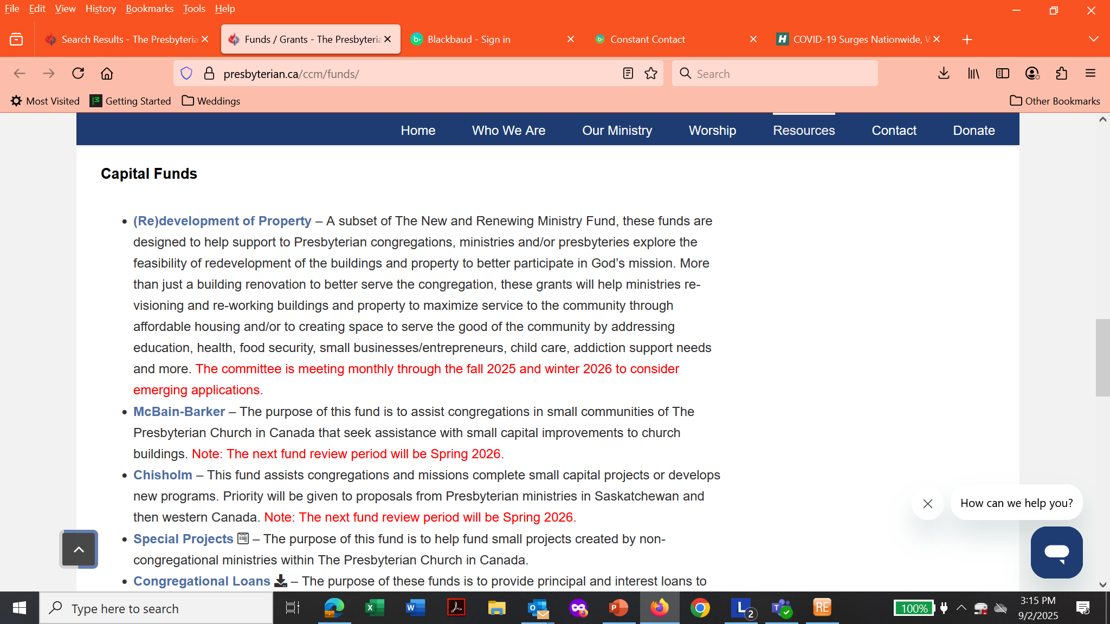
presbyterian.ca/ccm/funds
KP

Slide 37
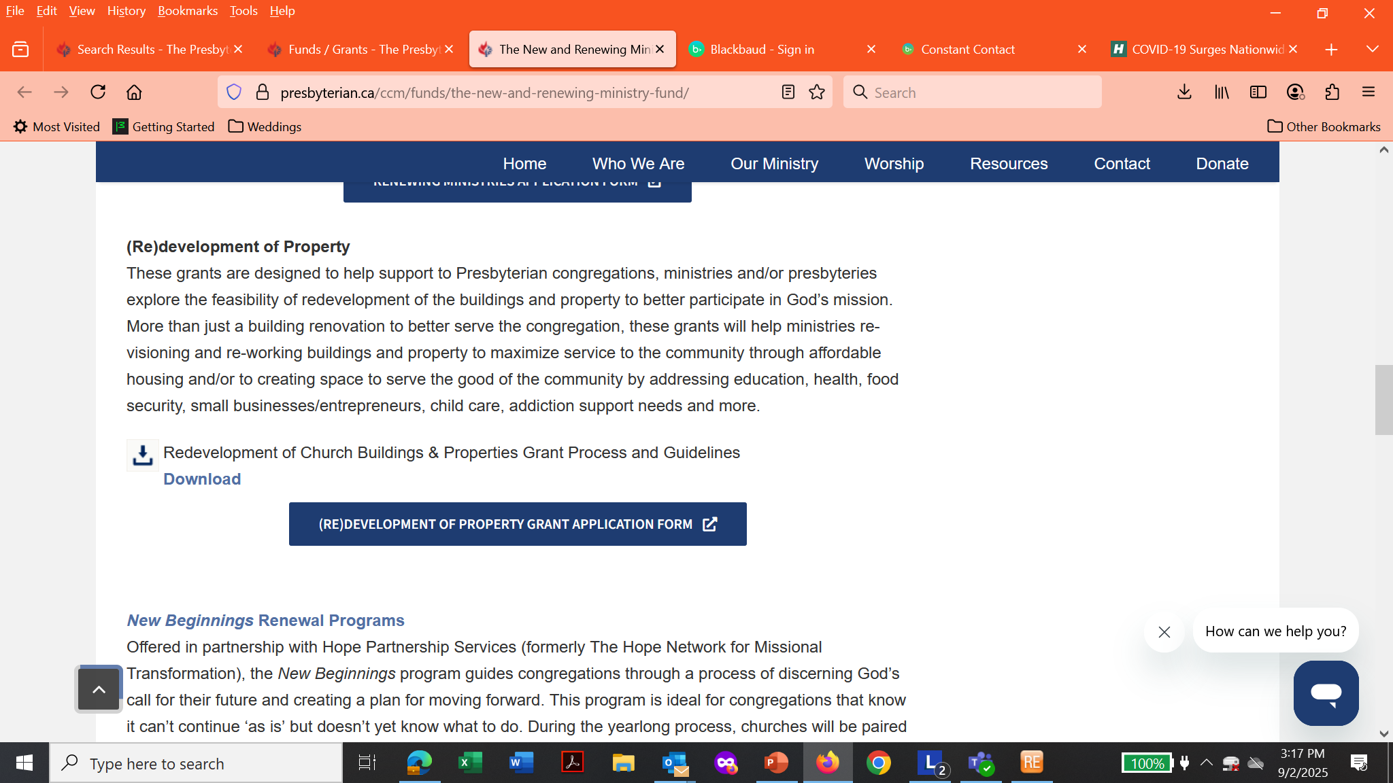
KP
presbyterian.ca/ccm/funds/the-new-and-renewing-ministry-fund/

Slide 38
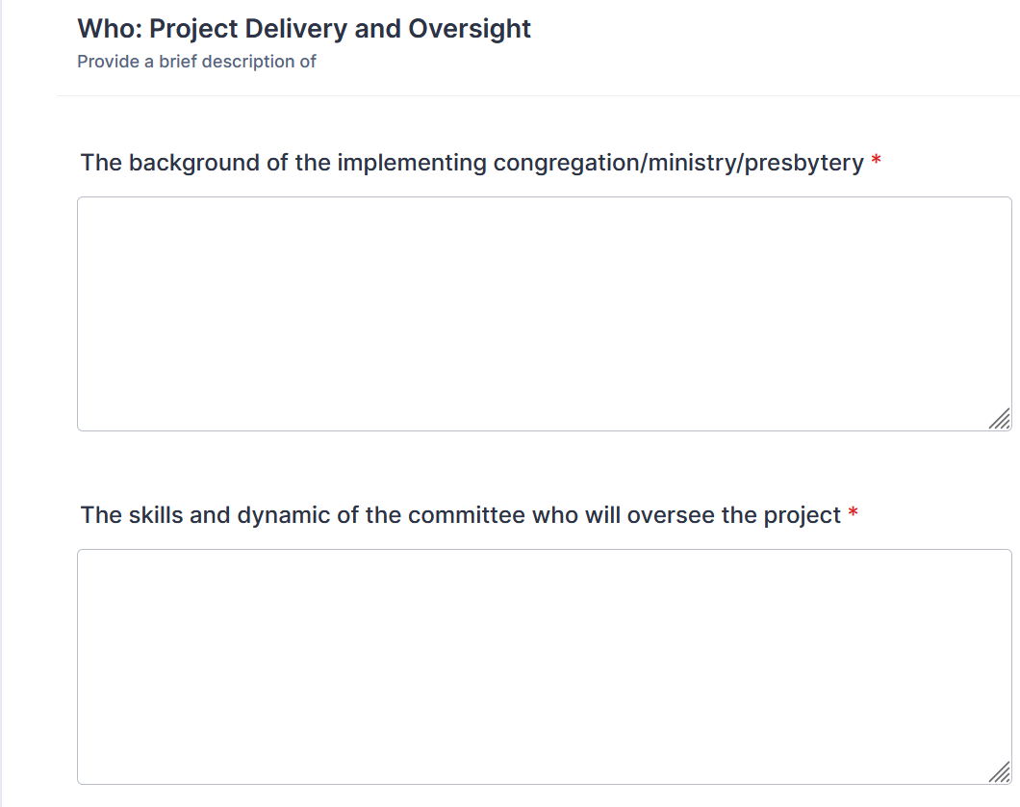

Project Delivery and Oversight
https://form.jotform.com/252046951638260
KP
EVOLVING PROCESS – We are learning with you!

Slide 39


What & Why (Purpose)
KP

Slide 40
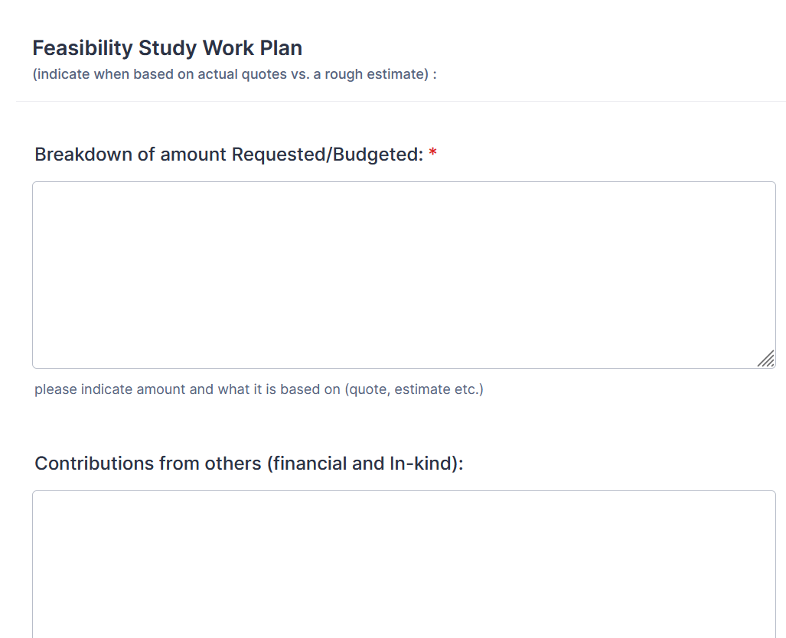
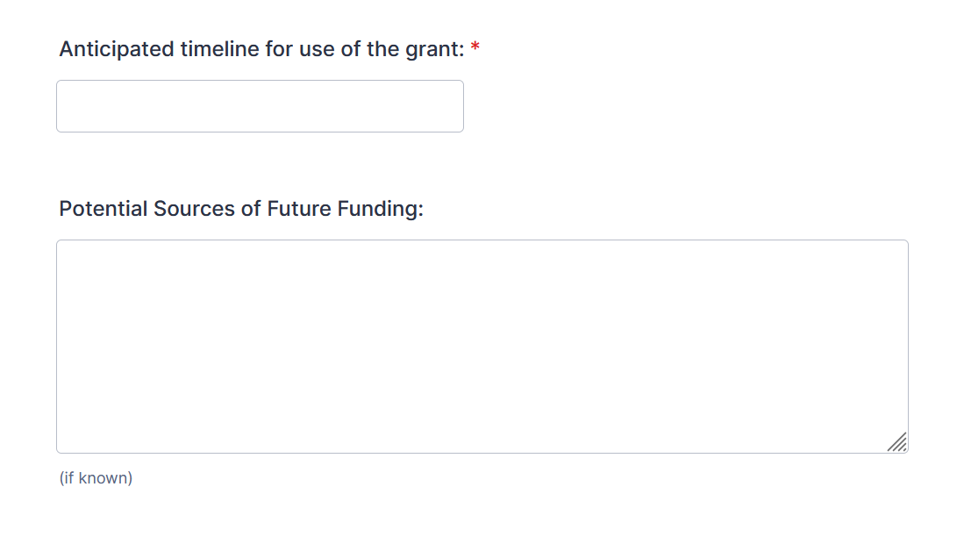
Feasibility Study Work Plan
KP

Slide 41
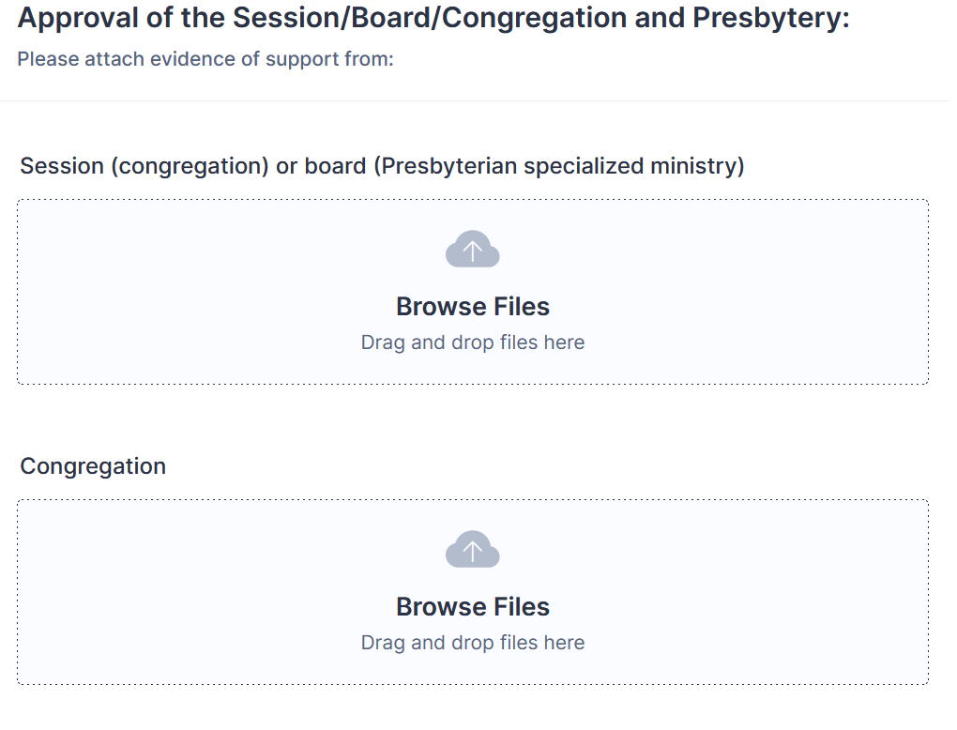

Approvals: Session, Congregation, Presbytery
KP

Slide 42
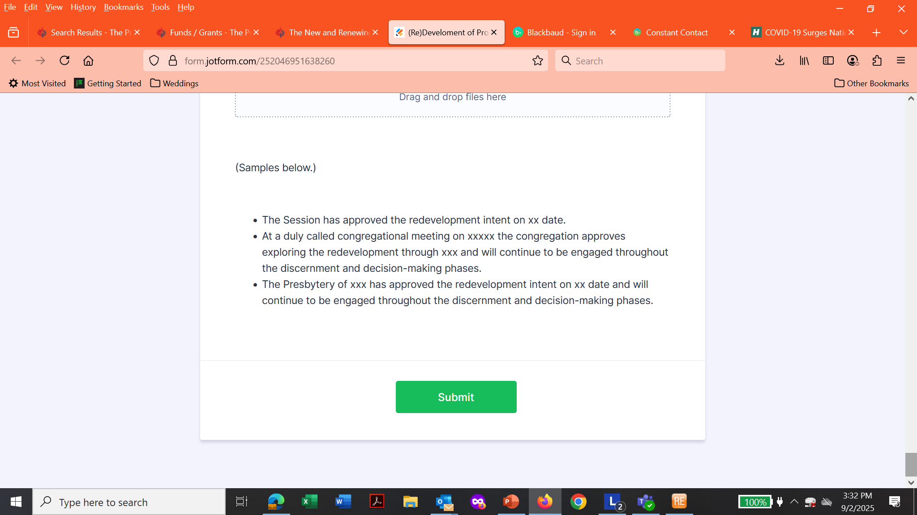
Submit
KP

Slide 43
Discussion
Questions
&
Feedback

Slide 44
Thank you!

